Slide 1
Lab Presentation II: Attack of the Clones
Rohan Maddamsettti 9/24/2010

Slide 2
Outline
Genotyping Project
Analysis Pipeline
“Movie” of fixations over time
10K clone phylogeny
Clone/Mixed Data Comparisons
Repair Gene/Mutation Project: Current status and ideas.

Slide 3
Project: The Genotyping
SNPs and indels previously found in the long-term lines through Jeff’s genomic work
Examine Allele Frequencies over time
Evolutionary Dynamics in 500 gen intervals.
Analogous to Mixed Population sequencing.

Slide 4
Genotyping: Analysis Pipeline
Mixed Population Genotyping:
Calibrate data based on known standards.
Average calibrated data for two independent replicate datasets.
Clone Genotyping:
Directly Calculate Genotype Frequencies.
Estimate Allele Frequencies independently.

Slide 5
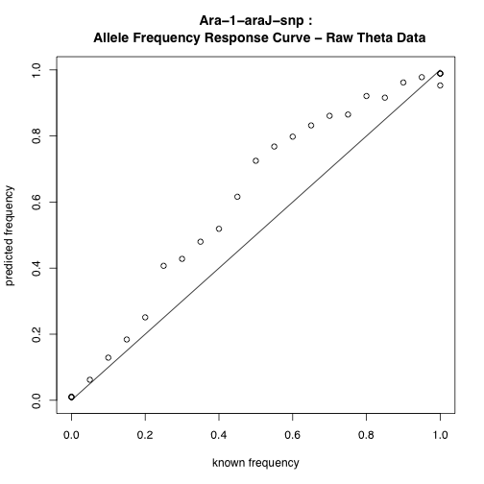
Genotyping Calibration

Slide 6
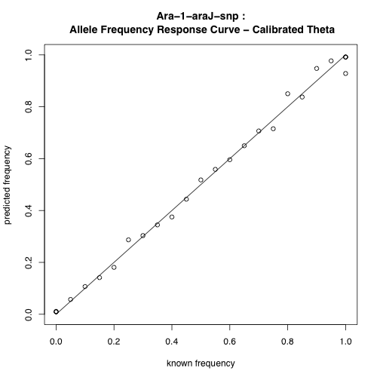
Genotyping Calibration

Slide 7
“Movie” of Fixations over time

Slide 8
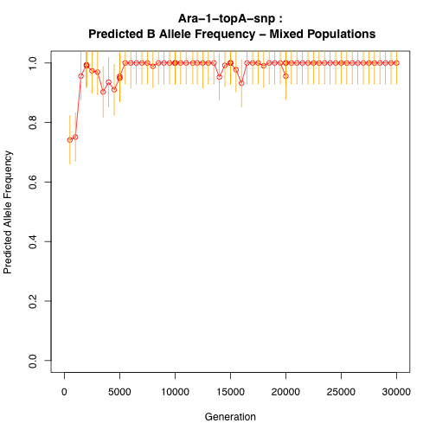

Slide 9
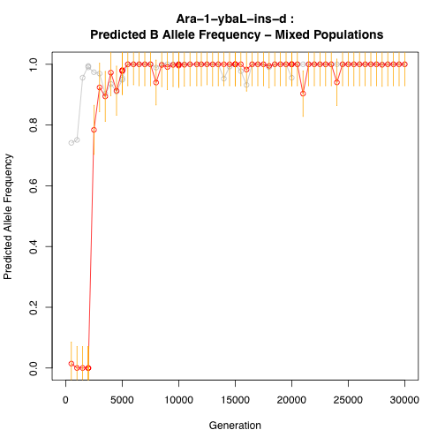

Slide 10
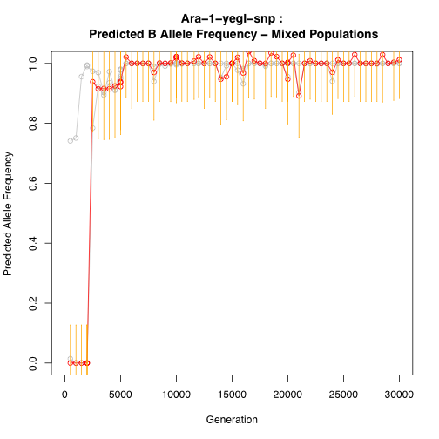

Slide 11
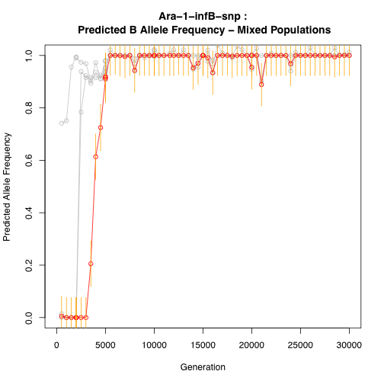

Slide 12
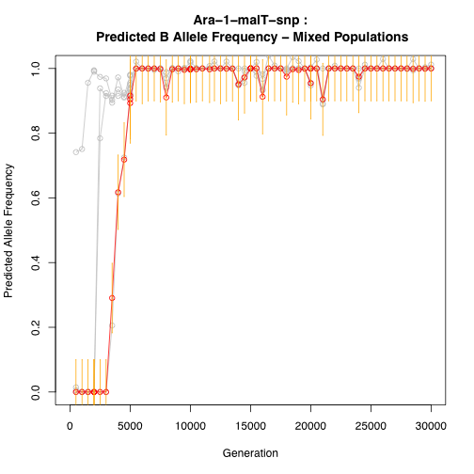

Slide 13
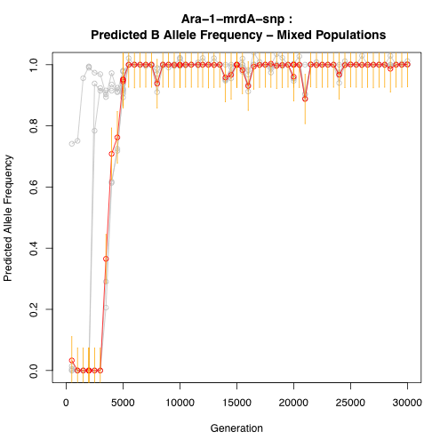

Slide 14
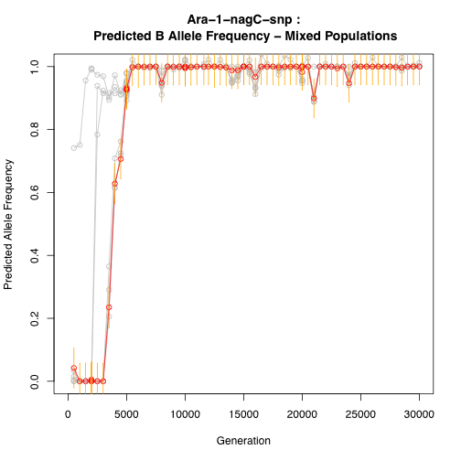

Slide 15
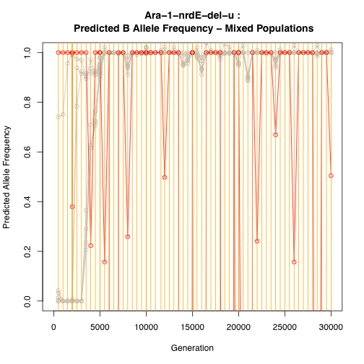

Slide 16
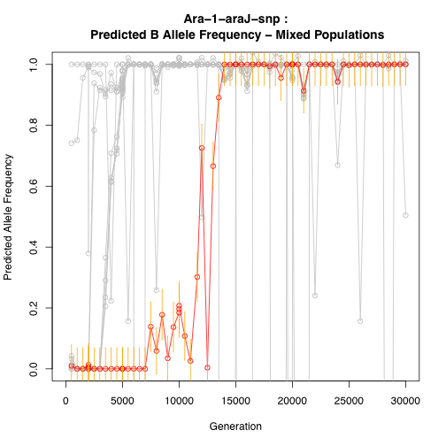

Slide 17
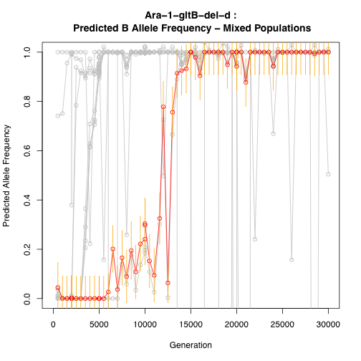

Slide 18
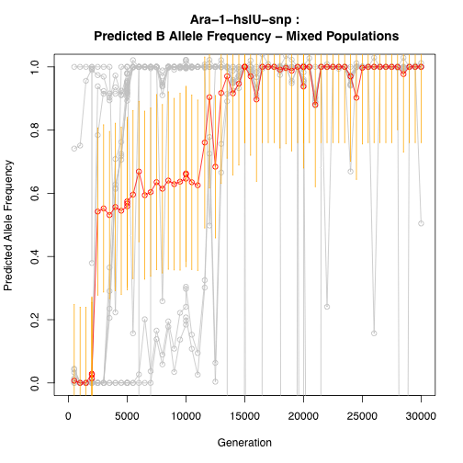

Slide 19
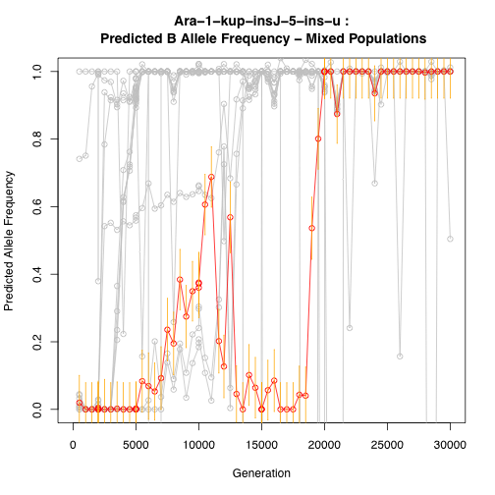

Slide 20
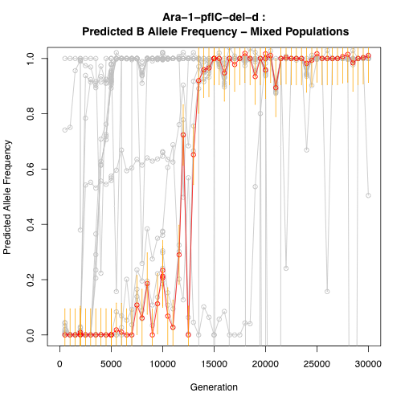

Slide 21
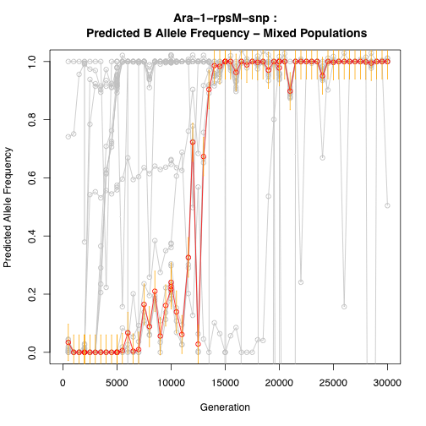

Slide 22
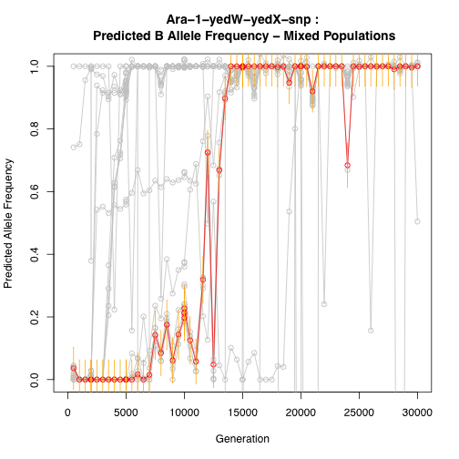

Slide 23
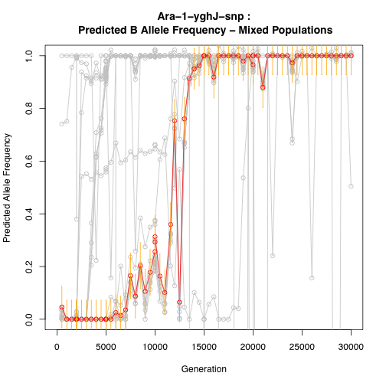

Slide 24


Slide 25
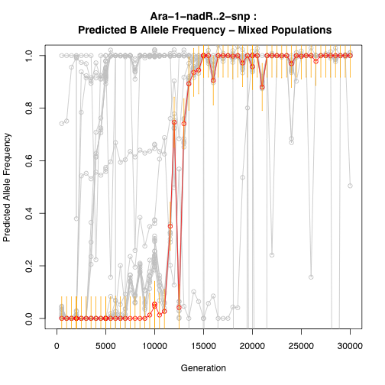

Slide 26
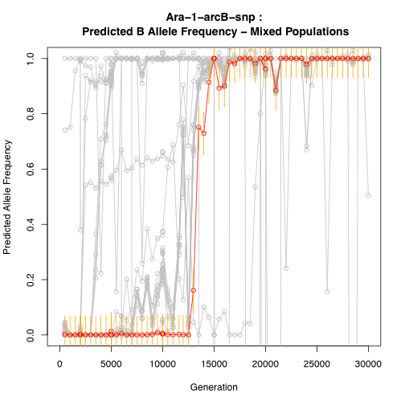

Slide 27
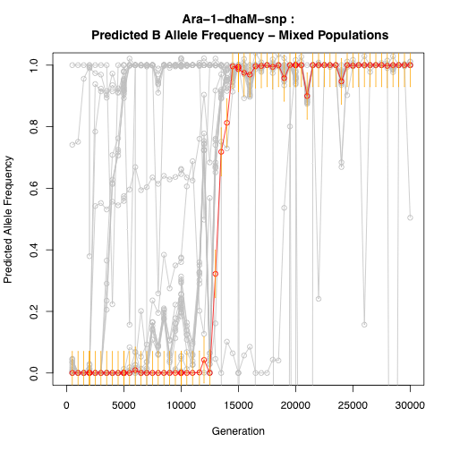

Slide 28
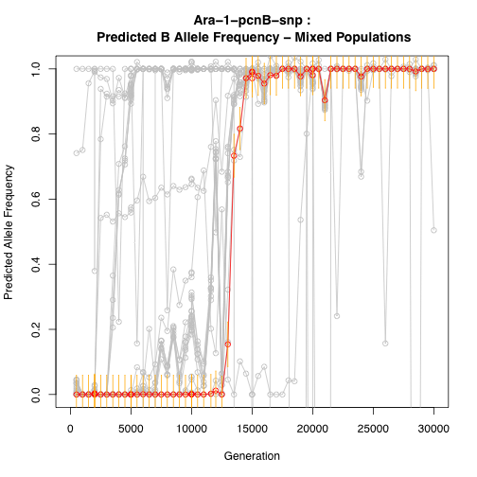

Slide 29
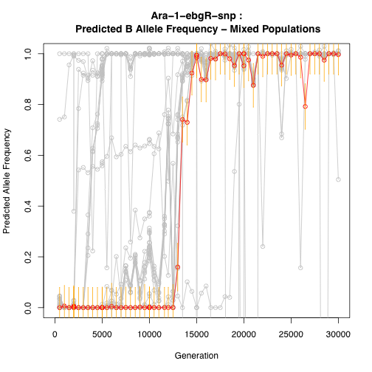

Slide 30
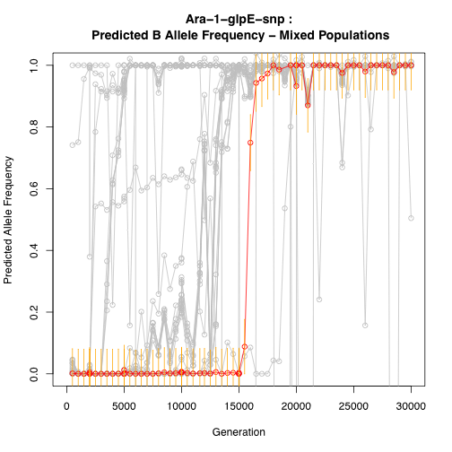

Slide 31
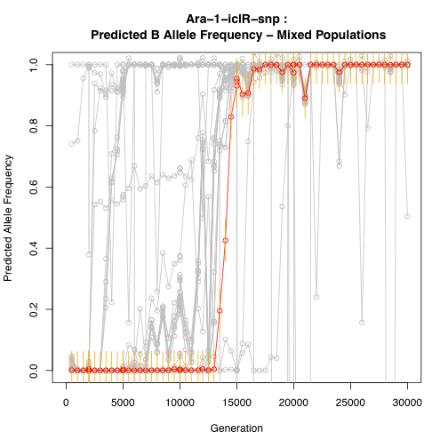

Slide 32
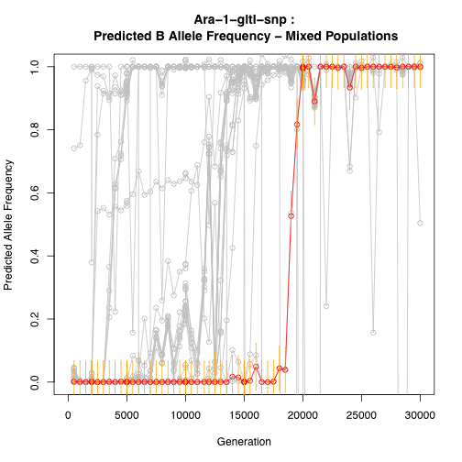

Slide 33
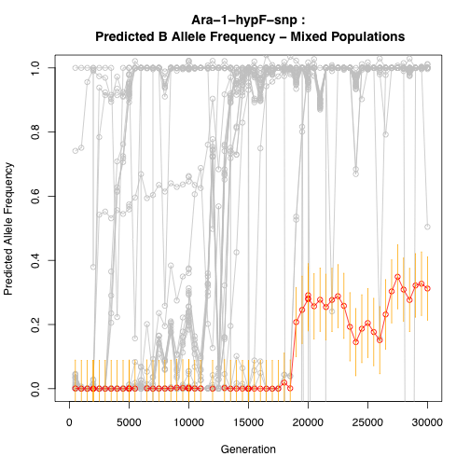

Slide 34
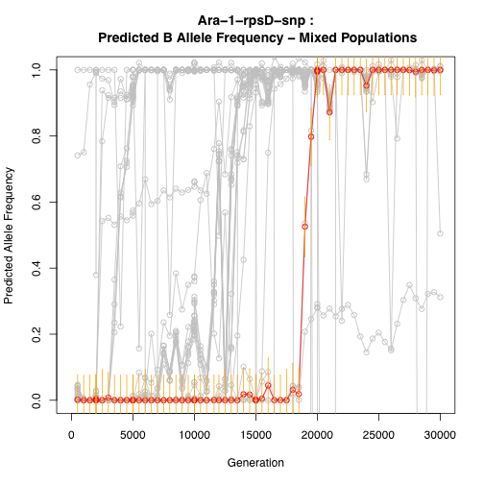

Slide 35
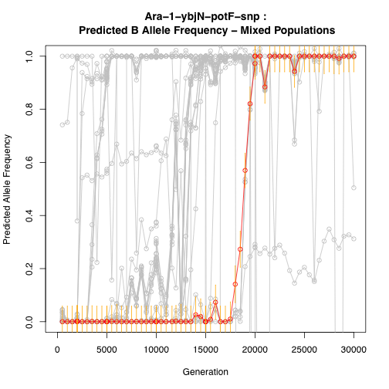

Slide 36
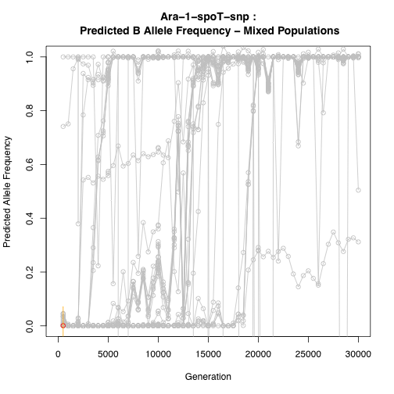

Slide 37
Comparison of Data between Mixed Pop. Datasets

Slide 38
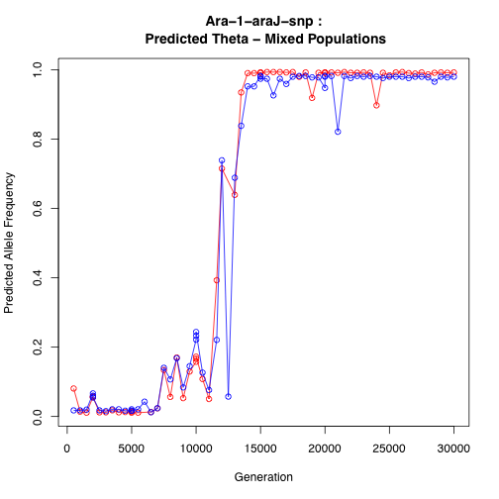

Slide 39
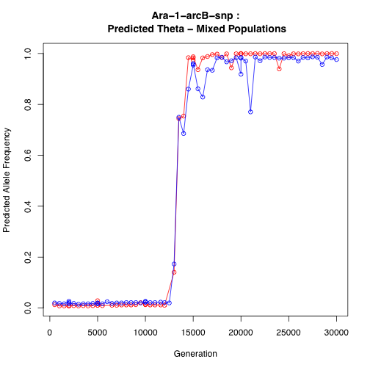

Slide 40
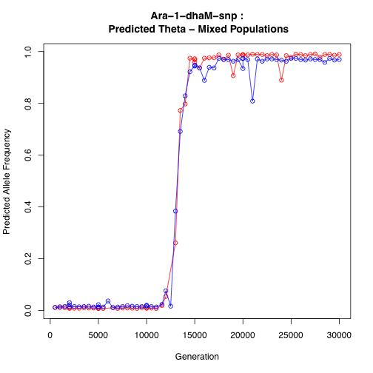

Slide 41
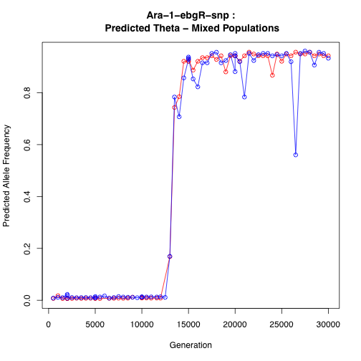

Slide 42
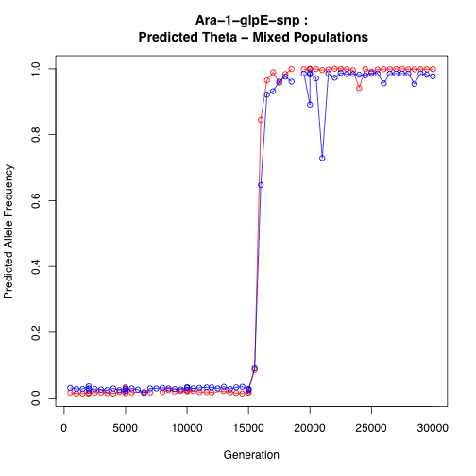

Slide 43
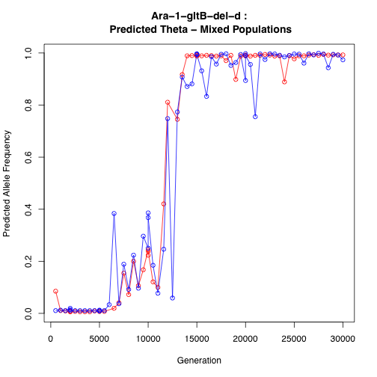

Slide 44
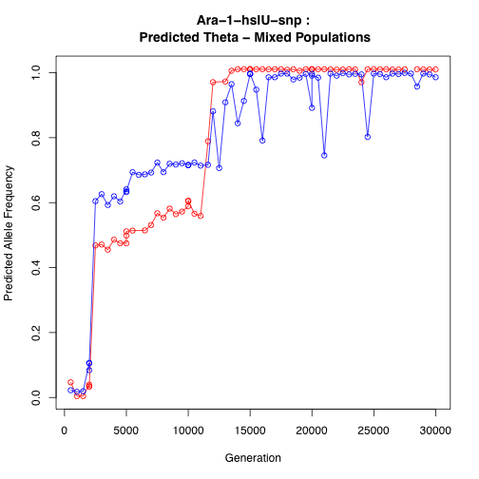

Slide 45
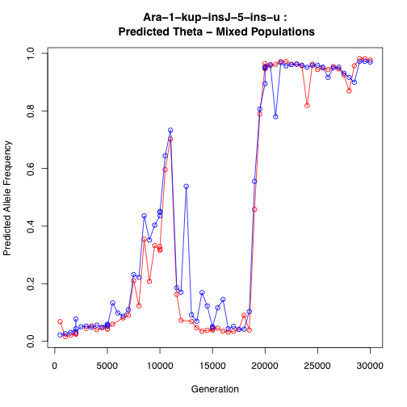

Slide 46
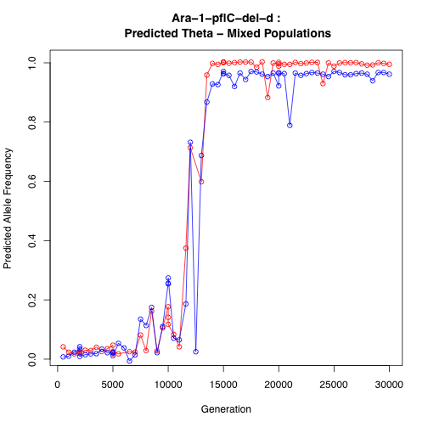

Slide 47
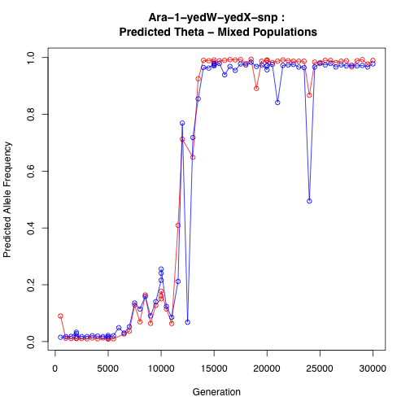

Slide 48
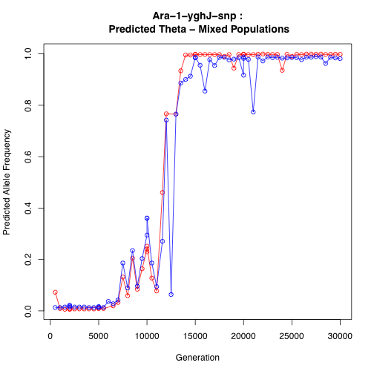

Slide 49
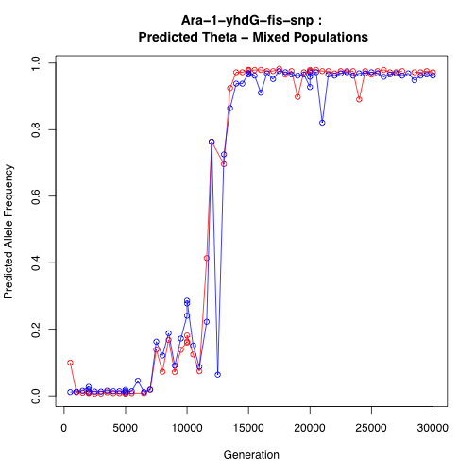

Slide 50
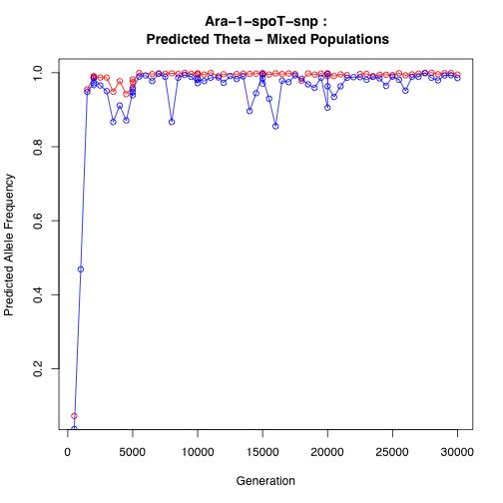

Slide 51
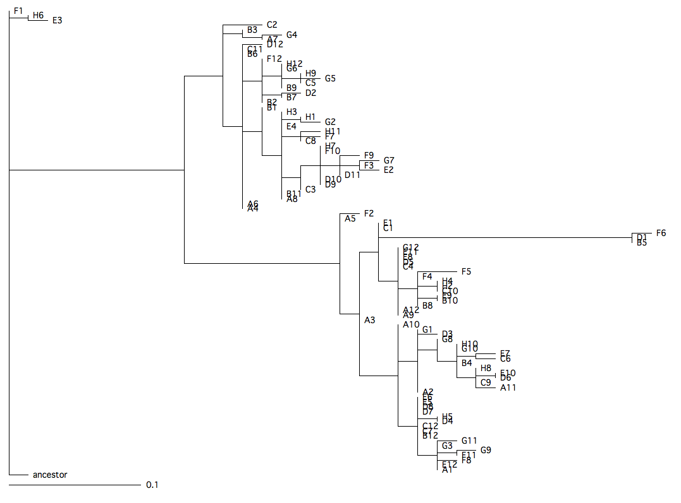
10K clone phylogeny

Slide 52
Comparison of Allele Frequency measurements: Clones versus Mixed Populations

Slide 53
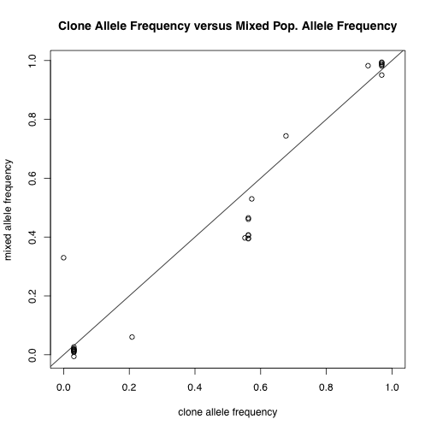

Slide 54
Questions/Directions
I ought to collect more clone datasets: which time points are interesting?
Calculate Malthusian Fitness parameters?
What can we say about the order/dynamics of mutations?

Slide 55
Repair Gene Project
Question: why is there such a diversity in mutation rates and spectra across the tree of life?
Hypothesis: the gain/loss of DNA repair genes drives changes in mutation rates/spectra
Prediction: GC content at 4-fold redundant sites is correlated with gain/loss of relevant mutator genes.

Slide 56
Known µ rates and composition
Lynch (2010)

Slide 57
Project Outline
Get GC content data for 1025 bacteria
Get repair genes for these same bacteria
For these organisms, look for changes in their repair gene repertoire
Compare pairs of organisms with a single difference (gain/loss) in repertoire for concomitant change in GC content

Slide 58
Procedure I
Search set: all manually annotated proteins with “DNA repair” GO annotation
Map these onto HAMAP ortholog families (~50) and Pfam domains (~120)
HAMAP: High-quality Automated and Manual Annotation of microbial Proteomes
Manually curate these data for proteins/domains that might affect GC content.

Slide 59
Procedure II
Calculate GC content at 4-fold sites for HAMAP species.
Build a phylogeny using 16S rDNA sequence.
Statistical approach: Independent phylogenetic contrasts

Slide 60
Status
Nathan is building 16S rDNA phylogenies for my organisms, and recollecting GC content data.
Casey is annotating the HAMAP and Pfam datasets.

Slide 61
Issues
Should I control for codon usage?
Power analysis: Is this project worthwhile?
Statistical inference: are there better/more powerful methods out there?
Ecology: should I collect these metadata, and can I infer ecological effects if my results are not significant?
Interactions/correlations between repair genes and environment

Slide 62
Thoughts
Given a negative result and enough power, can I infer that ecological effects play a greater role in shaping genome content?
I’d rather finish this project, than work on these ecological questions.
What should I do if power is inadequate?
Any thoughts on statistical design?

